Slide 1

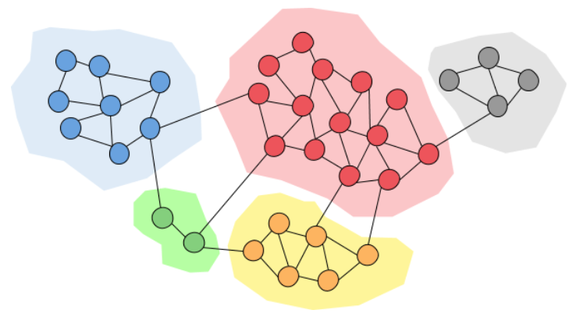
Machine Learning Final exercise- Label Propagation Graph Clustering for social networks
Dr. Ami Hauptman
amih@mail.sapir.ac.il
Presented by: Lion Miakshin & Yarin Ackerman

Slide 2
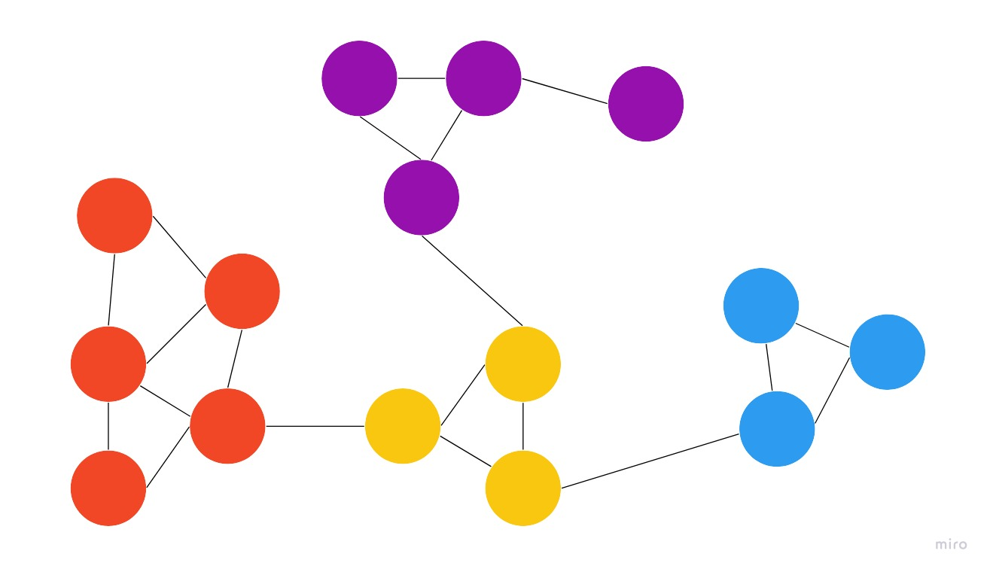
Introduction
Dive into label propagation, a potent semi-supervised ML tool.
Revealing Patterns: See how label propagation uncovers hidden structures.
Leveraging Unlabeled Data: Watch as it labels unmarked data, maximizing dataset value.
Introduced by Zhu Xiaojin, Zoubin Ghahramani, and John Lafferty, 2002.

Slide 3
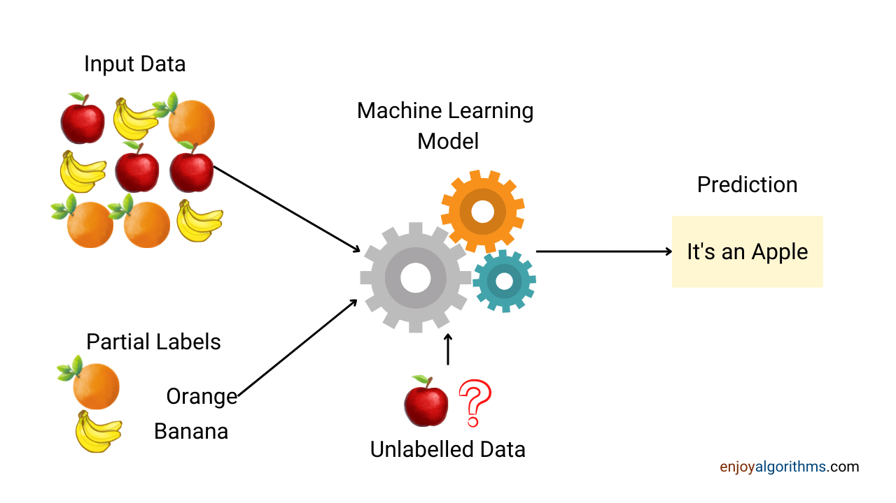
Introduction – Semi-Supervised Learning
Bridges the gap between supervised learning (abundant labeled data) and unsupervised learning (only unlabeled data available).

Slide 4
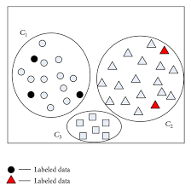
Semi-Supervised Learning cont.
Goal: leverage both labeled and unlabeled data to improve the performance of learning algorithms.
Obtaining labels for real data
Difficult and expensive
Time-consuming
Unlabeled data easier to collect
Semi supervised techniques:
Make the most out of this
Utilize unlabeled data
With limited labeled data

Slide 5
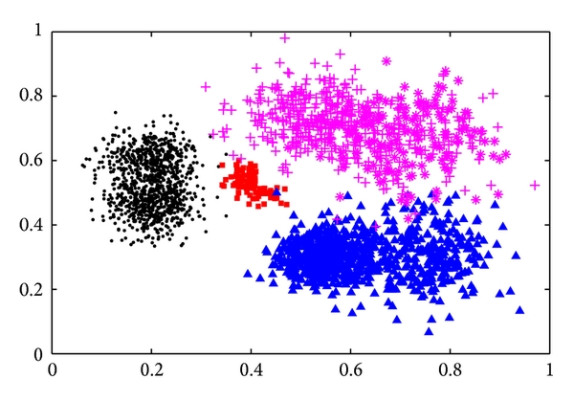
Semi-Supervised Learning cont. why not supervised or unsupervised learning
Supervised disadvantages:
Supervised learning requires a large amount of labeled data for training.
Acquiring labeled data can be expensive, time-consuming, or even infeasible in some cases.

Slide 6
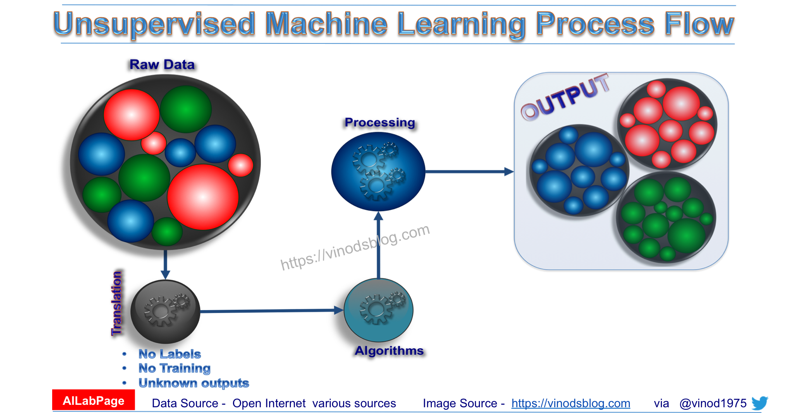
Semi-Supervised Learning cont. why not supervised or unsupervised learning
Unsupervised disadvantages:
Unsupervised learning algorithms aim to discover patterns, structures, or relationships in the data without explicit labels.
it may not provide the desired level of specificity or accuracy required for certain tasks.

Slide 7

General Approach:
We want to rely on labeled data and to use it as an indication for unlabeled data points:
Targets:
Limited labeled data- we want to leverage the available labeled data.
Noise tolerance- we need something against noisy or mislabeled data.
Scalability: dealing with large data sets.
Note:
Strongly depends on similarity between neighbors.
There are some possibilities that the method will not work correctly.
mislabeled or noisy data.
Inconsistent, not always working.

Slide 8
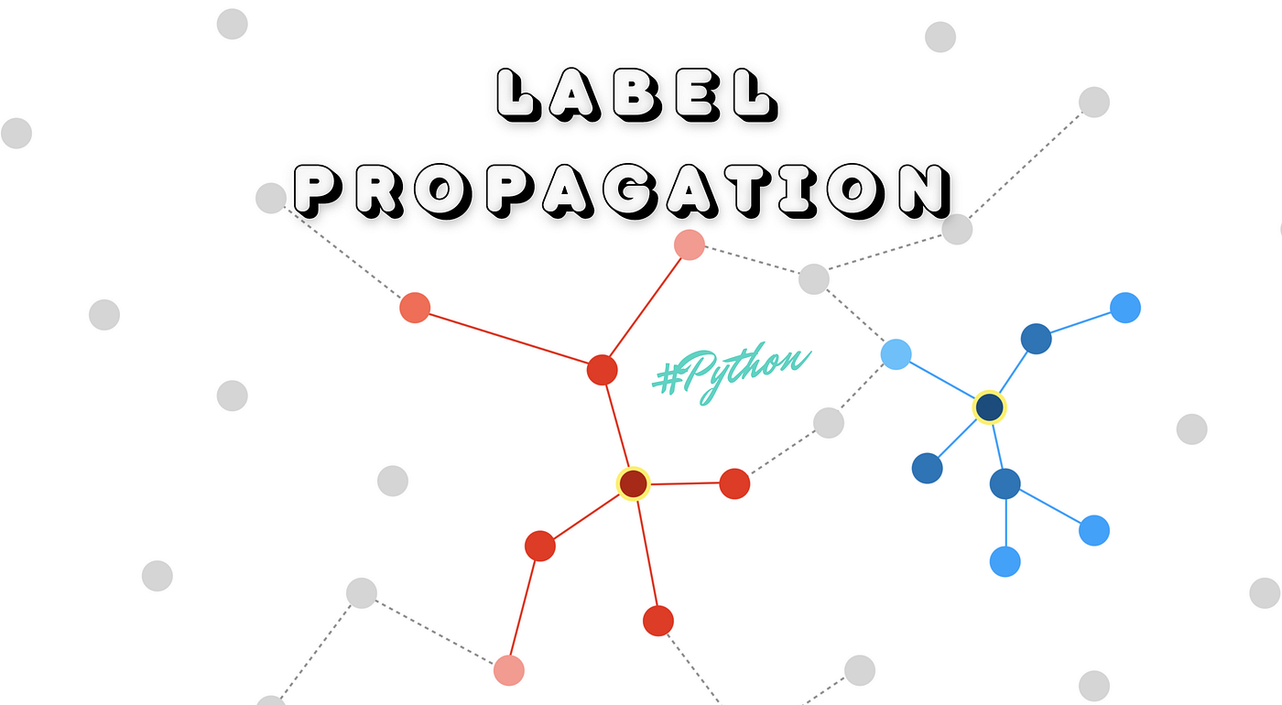
Label Propagation:
Semi-supervised learning: Leveraging both labeled and unlabeled data to improve learning algorithms.
Label Propagation: A powerful algorithm for semi-supervised learning.
Utilizing unlabeled data: Expanding the training set and capturing underlying data relationships

Slide 9
Social Networks: Definition
Social networks are intricate digital ecosystems where individuals:
- connect.
- communicate.
- share information.
Enabling people to:
- stay in touch.
- discover content.
- engage with communities of interest.

Slide 10
Features and Data in Social Networks:
User Profiles: Users create profiles with personal details, photos, and interests.
Connections: Users establish connections by sending and accepting friend/follow requests.
Groups and Communities: Users join groups related to their interests or industries.
Events: Users can create or join events, both online and offline.
Data Types: Social networks collect demographics, preferences, behaviors, interactions, location data, and more.

Slide 11
Social Networks-Examples
Examples of Social Networks:
Facebook:
With over 2.8 billion monthly active users.
Facebook is a pioneer in connecting people worldwide.
It features profiles, friend connections, posts, and media sharing.
Twitter:
Characterized by its short posts (tweets).
Twitter has around 330 million monthly active users.
It focuses on real-time updates, trends, and hashtag-driven conversations.

Slide 12

Social Networks-Examples-cont.
Size and Data Volume:
Facebook: With billions of users, it stores vast amounts of personal information, interactions, and connections.
Twitter: Generates about 6,000 tweets per second, accumulating a colossal real-time dataset.

Slide 13

Social Networks
Challenges and Opportunities:
Data Variety: Diverse data types require advanced analytics.
Privacy Concerns: Balancing user data utilization and privacy protection.
Information Overload: Extracting valuable insights from vast data volumes.

Slide 14
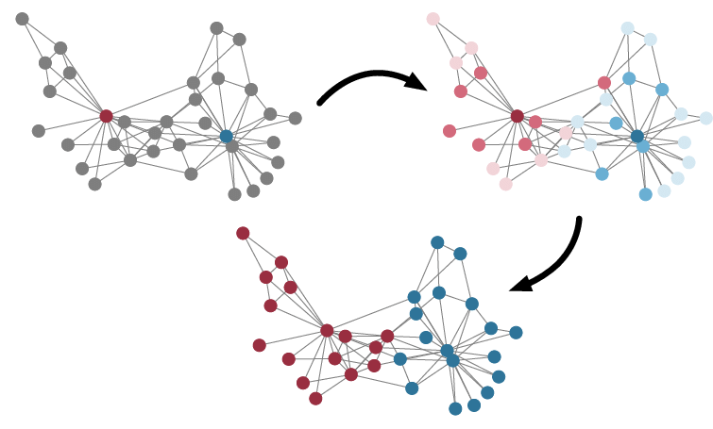
Label Propagation Description
Label Propagation transforms limited labeled data into valuable insights.
Enables accurate predictions and improved models.
A powerful approach in navigating real-world data complexities.

Slide 15
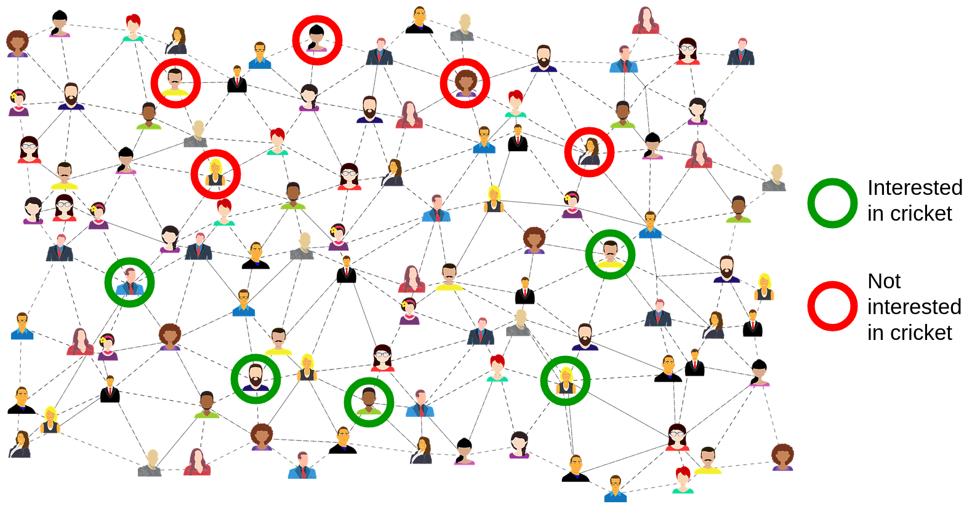
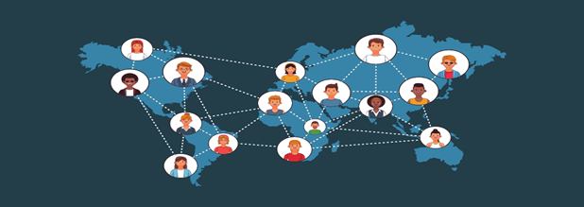
How label propagation works
Label Propagation – semi-supervised method works on graph G=(V,E) – graph that shows the connections between nodes (people) by using edges (connections between them).

Slide 16
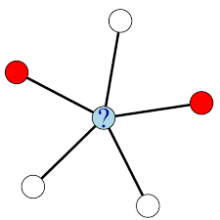
How label propagation works-cont.
We use 3 different classifiers:
Local classifier- This is a local learned model, predicts node label based on node attributes. No network information.
Relational classifier – Takes into account labels and attributes of node neighbors. Uses neighborhood network information.
Collective classifier- estimates unknown values together applying relational classifier iteratively. strongly depends on network structure
Relational Classifier case

Slide 17
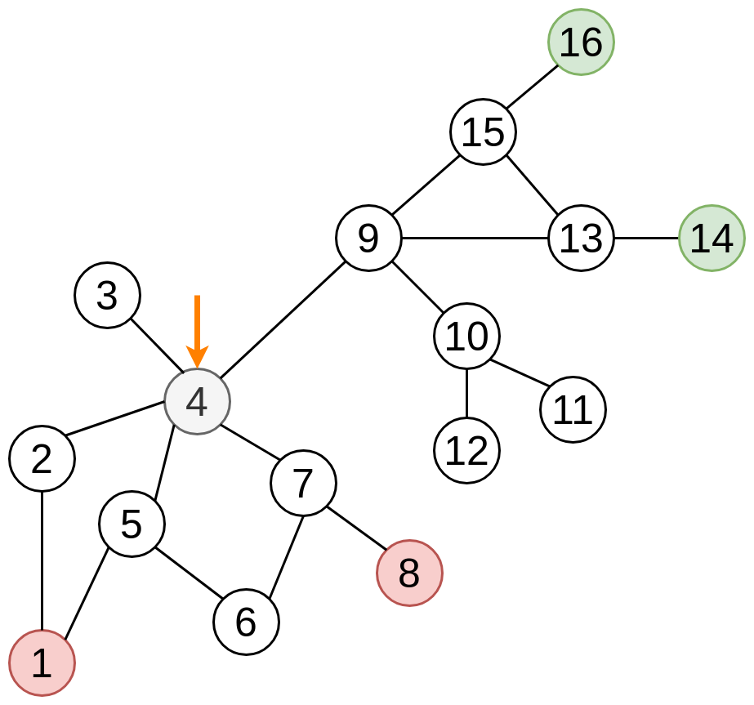
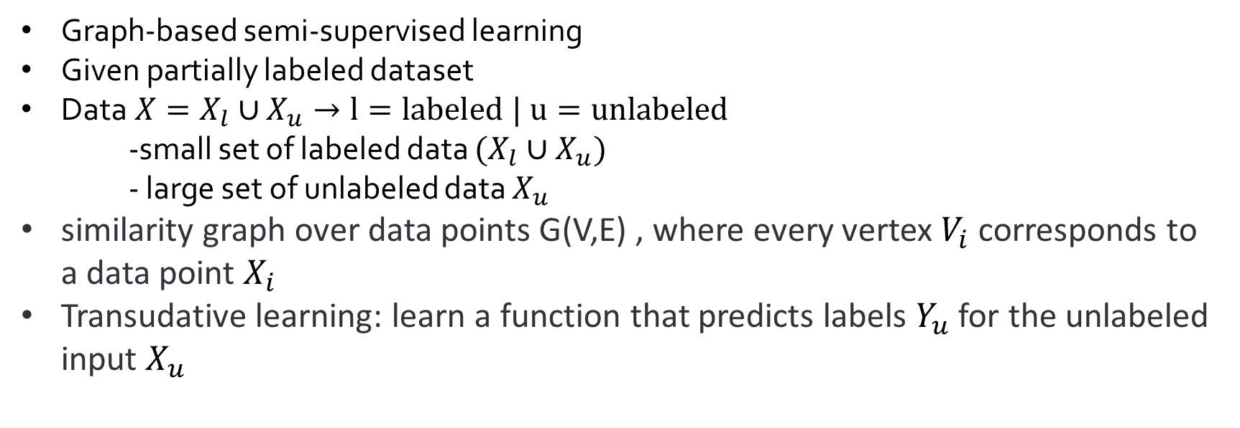
Label Propagation – Algorithm
Graph-based semi-supervised learning
Given partially labeled dataset
Data$X=X_{l}∪$ $X_{u}→l=labeled | u=unlabeled$
-small set of labeled data $(X_{l}∪X_{u})$
- large set of unlabeled data $X_{u}$
similarity graph over data points G(V,E) , where every vertex $V_{i}$ corresponds to a data point $X_{i}$
Transudative learning: learn a function that predicts labels $Y_{u}$ for the unlabeled input $X_{u}$

Slide 18
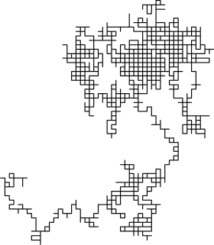
Label Propagation – Random Walk method
For the execution of label propagation, we will need an intuitive implementation:
Random walk:
Simulates information diffusion in graphs.
Nodes with alike labels tend to connect.
Efficient implementation for label spreading.
Utilizing Random Walk:
Capitalizes on graph structure for label diffusion.
Leverages natural connections between similar data points.
Offers an intuitive and efficient approach to propagate labels.

Slide 19
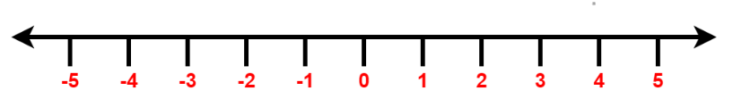
Random Walk method
Let S be our starting point, we flip a coin.
If it land on tails, we move right, otherwise we move left.
what is the probability to reach a certain point with K steps?
S

Slide 20
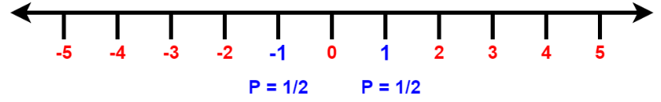
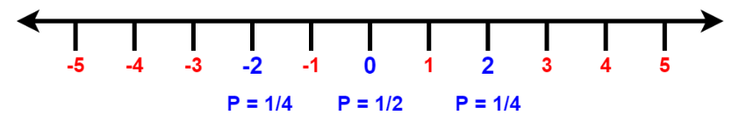
Random Walk method
Example:
one step from S:
Red= probability of 0
Few steps
Two steps from S:
What about N steps?

Slide 21
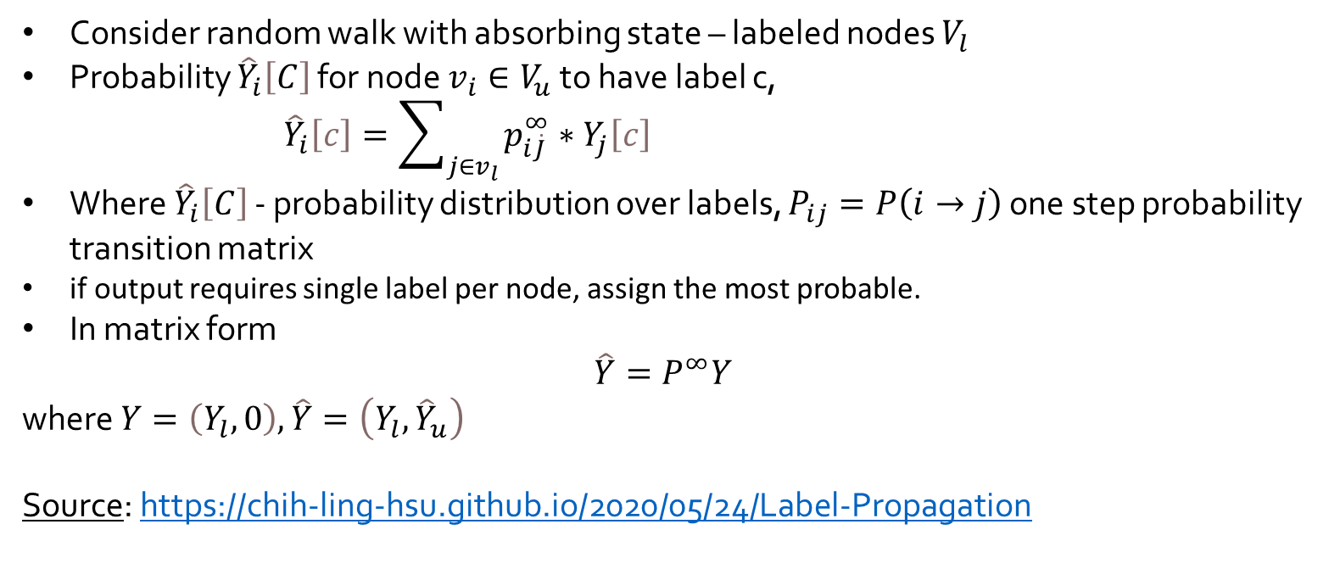
Random Walk method
Consider random walk with absorbing state – labeled nodes $V_{l}$
Probability ${\hat{Y}}_{i}\left[C\right]$ for node $v_{i}∈V_{u}$to have label c,
${\hat{Y}}_{i}\left[c\right]=\sum_{j∈v_{l}}{p_{ⅈ\dot{J}}^{∞}}∗Y_{j}\left[c\right]$
Where ${\hat{Y}}_{i}\left[C\right]$ - probability distribution over labels, $P_{ij}=P\left(i→j\right)$ one step probability transition matrix
if output requires single label per node, assign the most probable.
In matrix form
$$\hat{Y}=P^{∞}Y$$
where $Y=\left(Y_{l},0\right),\hat{Y}=\left(Y_{l},{\hat{Y}}_{u}\right)$
Source: https://chih-ling-hsu.github.io/2020/05/24/Label-Propagation

Slide 22
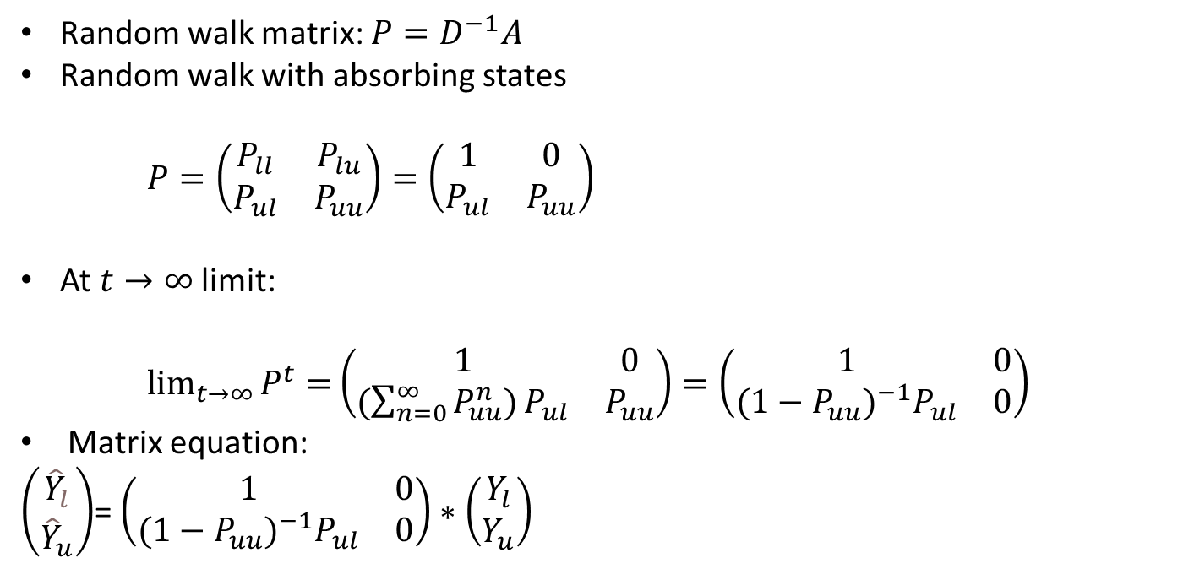
Random Walk method-cont.
Reached point with no exit (in our case: labeled nodes)
Random walk matrix: $P=D^{−1}A$
Random walk with absorbing states
$P=\left(\begin{matrix}P_{ll} & P_{lu} \\ P_{ul} & P_{uu}\end{matrix}\right)=\left(\begin{matrix}1 & 0 \\ P_{ul} & P_{uu}\end{matrix}\right)$
At $t→∞$limit:
$\lim_{t→∞}{P^{t}=}$ $\left(\begin{matrix}1 & 0 \\ {(\sum_{n=0}^{∞}{P_{uu}^{n})}P}_{ul} & P_{uu}\end{matrix}\right)=\left(\begin{matrix}1 & 0 \\ {{(1−P}_{uu})}^{−1}P_{ul} & 0\end{matrix}\right)$
Matrix equation:
$\left(\begin{matrix}{\hat{Y}}_{l} \\ {\hat{Y}}_{u}\end{matrix}\right)$= $\left(\begin{matrix}1 & 0 \\ {{(1−P}_{uu})}^{−1}P_{ul} & 0\end{matrix}\right)∗\left(\begin{matrix}Y_{l} \\ Y_{u}\end{matrix}\right)$
Probabilities:
ll→ label to label
lu→ label to un-label
ul→ un-label to label
uu→ un-label to un-label
Labeled nodes have no exit
Adjacency matrix

Slide 23
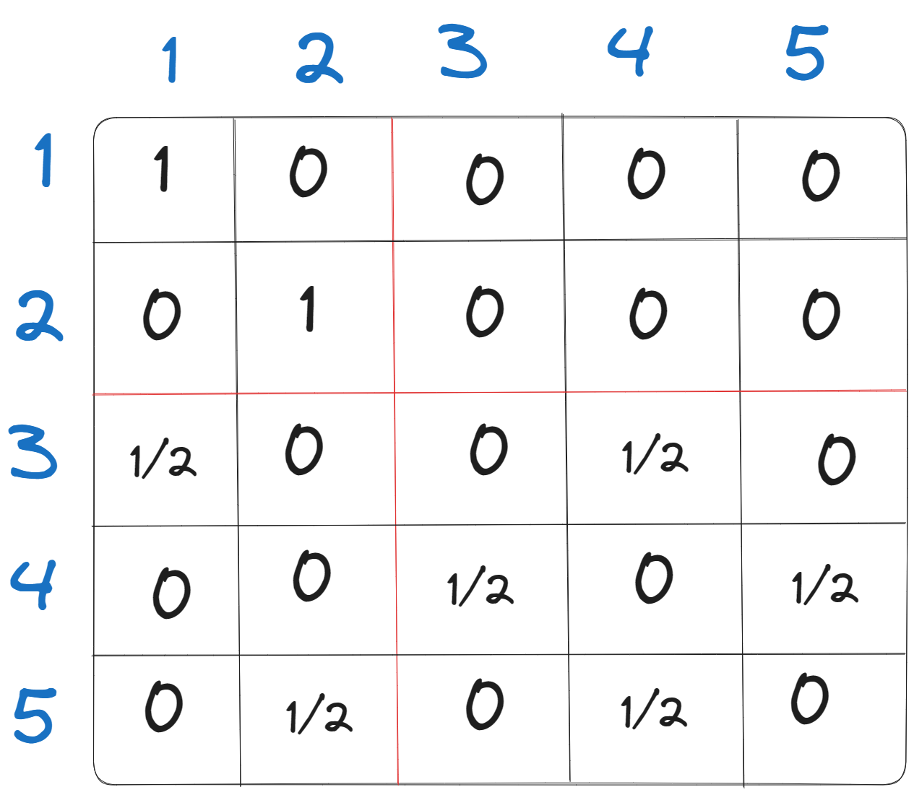
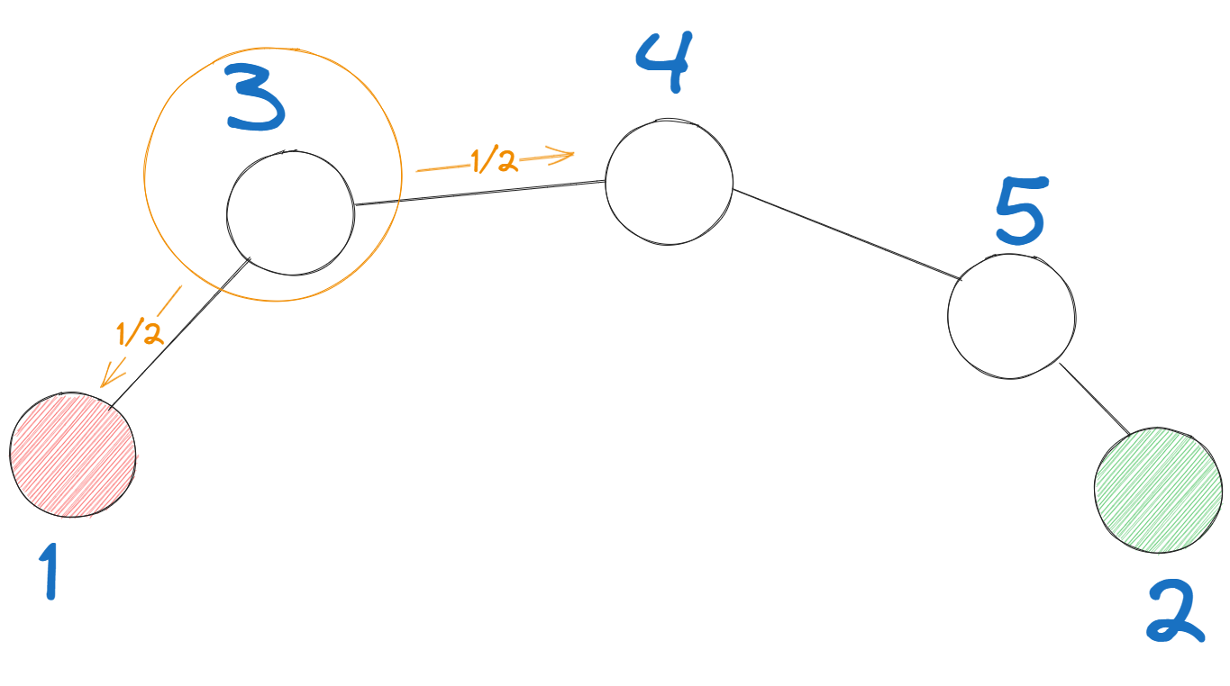
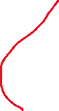
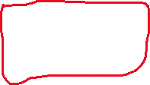
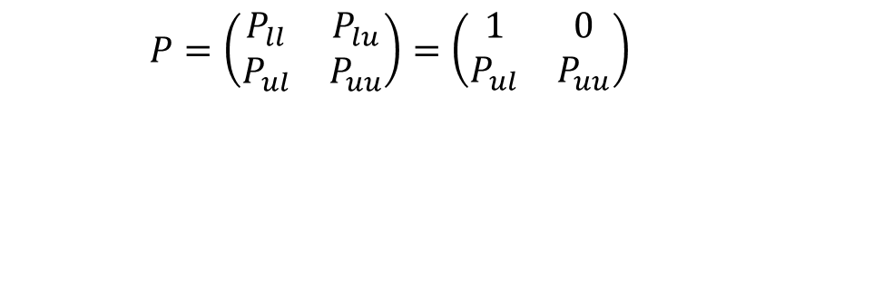
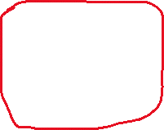
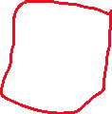
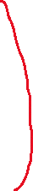
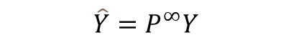
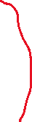
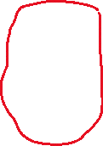
Random Walk method-Example
$$\hat{Y}=P^{∞}Y$$
First iteration
$P=\left(\begin{matrix}P_{ll} & P_{lu} \\ P_{ul} & P_{uu}\end{matrix}\right)=\left(\begin{matrix}1 & 0 \\ P_{ul} & P_{uu}\end{matrix}\right)$
Probability to choose node 4
Probability to choose node 1
P=
Probability matrix

Slide 24
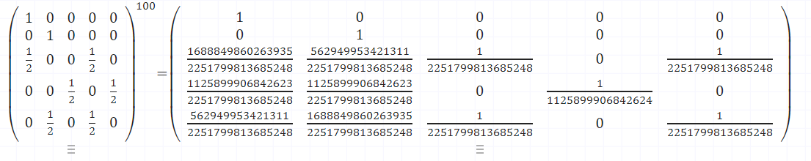
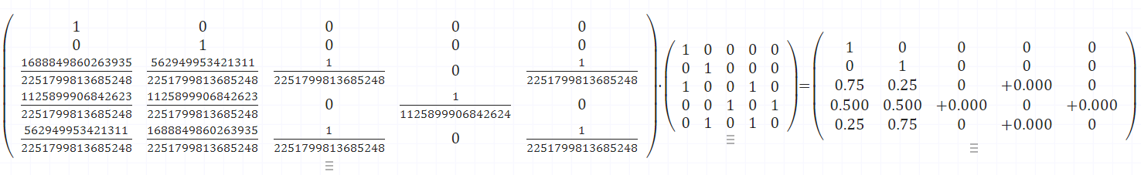
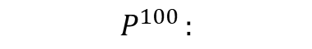
Random Walk method-Example cont.
$$P^{100 }:$$
$$P^{100}∗A_{adjacency matrix}=\hat{Y}$$

Slide 25
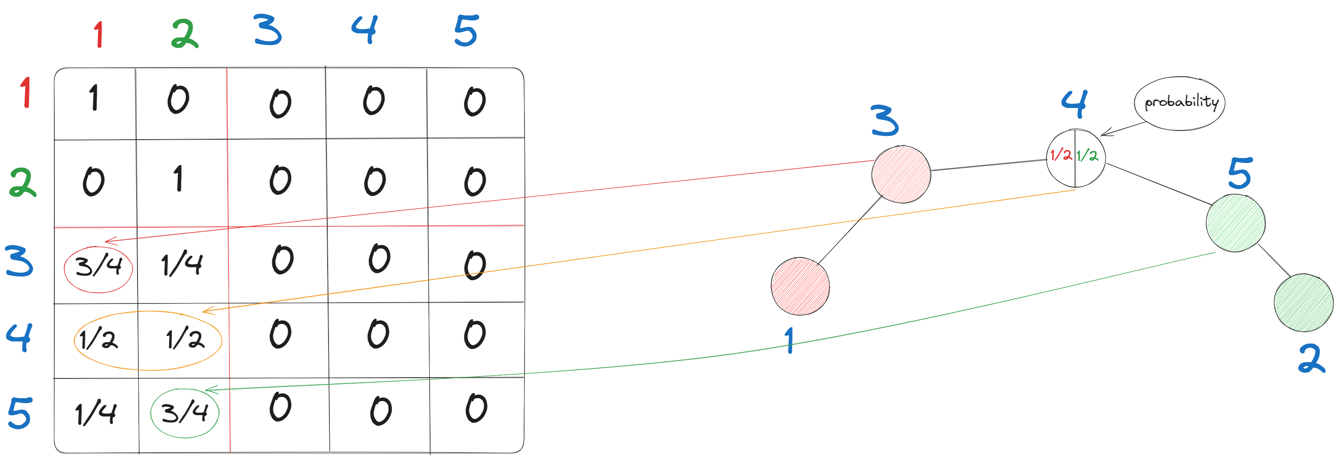
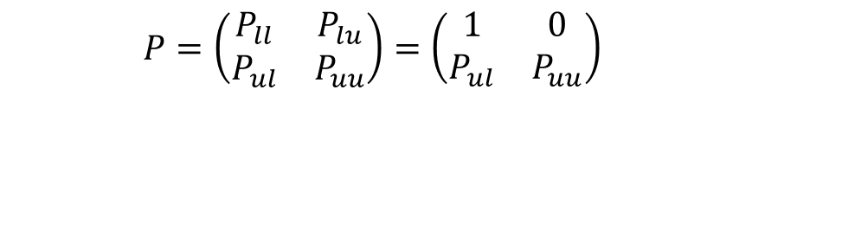
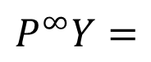

Random Walk method-Example
$$\hat{Y}=P^{∞}Y$$
N iteration
$P=\left(\begin{matrix}P_{ll} & P_{lu} \\ P_{ul} & P_{uu}\end{matrix}\right)=\left(\begin{matrix}1 & 0 \\ P_{ul} & P_{uu}\end{matrix}\right)$
$$P^{∞}Y=$$
Probability matrix ${\lim{n}→∞ P}^{n}$ until convergence

Slide 26
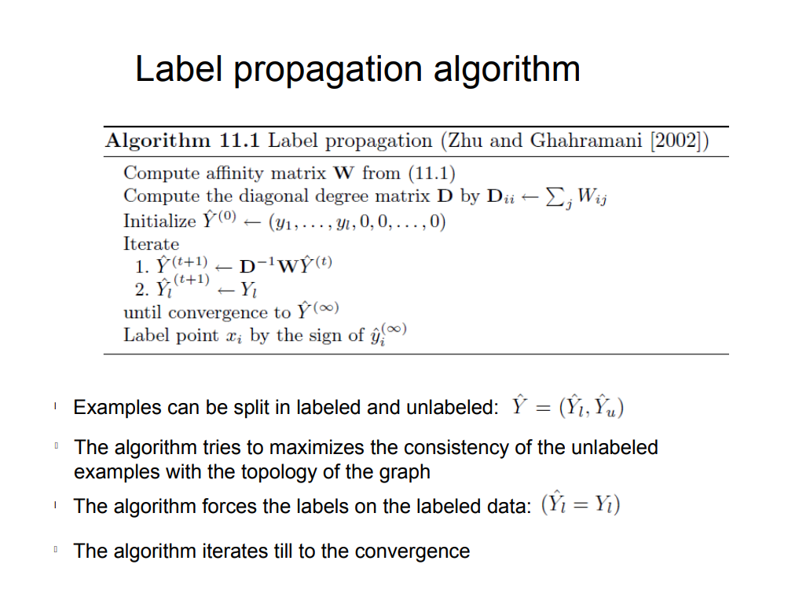
Pseudo code

Slide 27
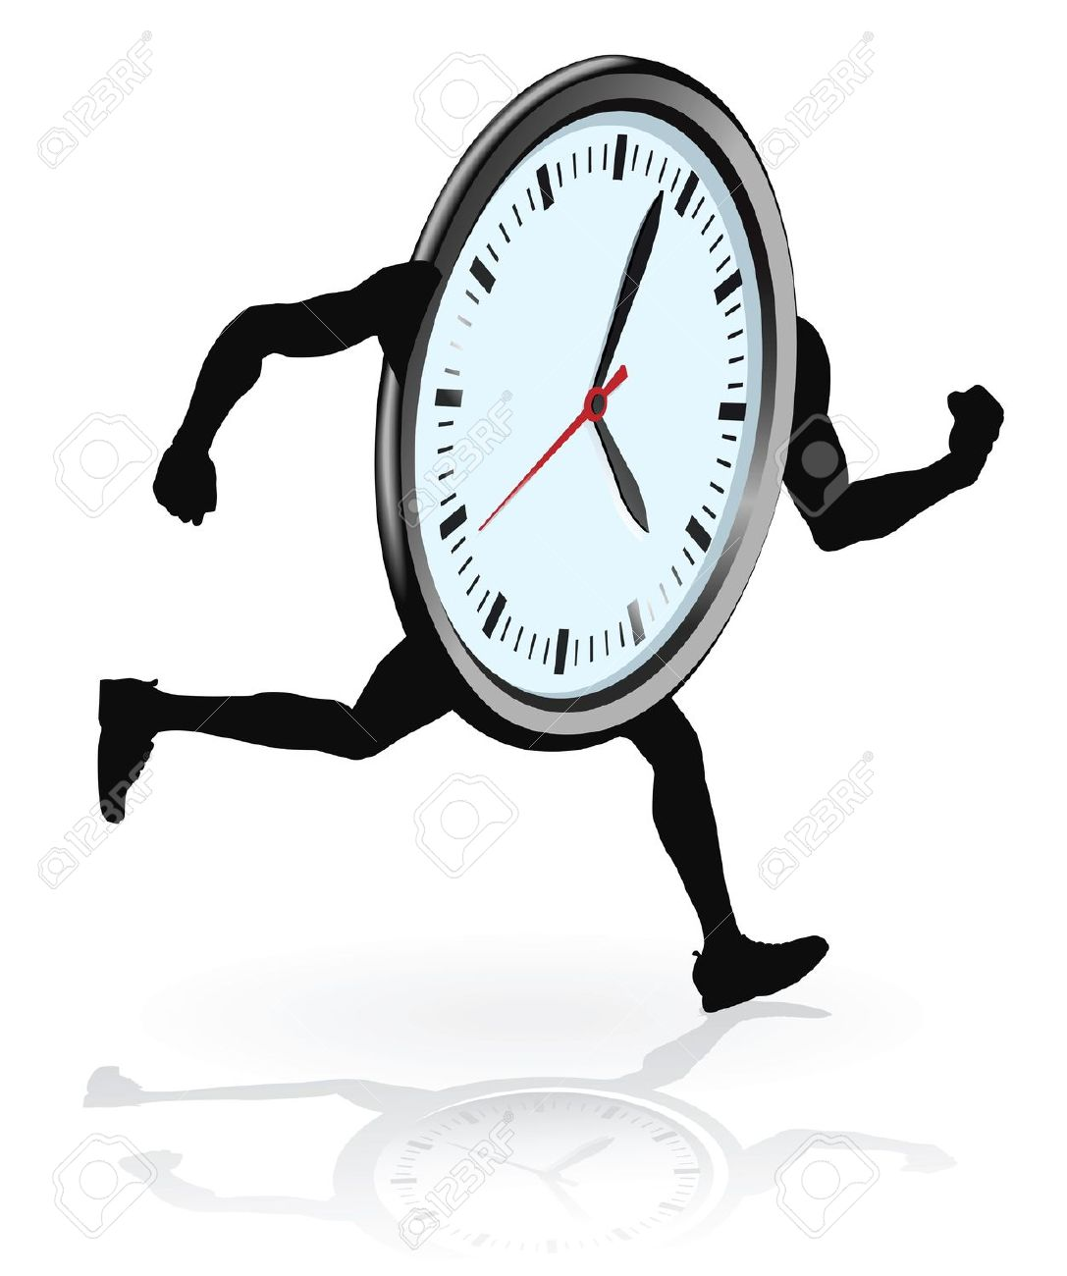
Running time
Contribution to Time Complexity:
Creating the probability matrix 𝑂(𝑉^2)
Multiplying the probability matrix with itself
Multiplying the probability matrix with the adjacency matrix 𝑂(𝑉^3)
Iterations vs. Nodes:
The convergence requires a relatively small number of iterations, denoted as k
Generally, k << number of nodes
Dominant Complexity Factor:
The matrix multiplication step becomes the primary driver of the overall complexity.

Slide 28
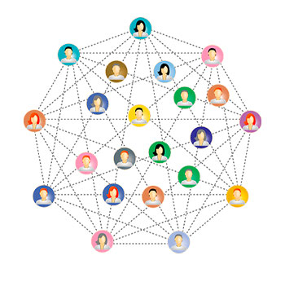
Label propagation for clustering in social networks
Democrats
Republicans

Slide 29
Label propagation for clustering in social networks
Democrats
Republicans

Slide 30

Implementation steps (octave):
Step 1: function [D,Y] = loadData(filename)→ this function loads the data from the dataset
Step 2: function [adjmatrix]= createMatrix(D,Y)→ creating an adjacency matrix by using the information of which
nodes are connected.
Step 3: function [probabilityMatrix] = createProbabilityMatrix(adjMatrix)→ this function creates the probability
matrix by counting the amount of degrees of each node has.
Step 4: function [probabilityMatrix,adjacencyMatrix,labelOne,labelTwo] = createLabeledData(probMatrix,adjMatrix)→
this function choose nodes and label them, that will help us label the other unlabeled nodes.

Slide 31

Implementation steps (octave) cont.:
Step 5: function [finalMatrix] = multiplyMatrix(adjMatrix,probMatrix,labelOne,labelTwo)→ this function multiplying the probability matrix by itself until the matrix convergence and then we multiplying the probability matrix with the adjacency matrix in order to get the whole labeled data.
Step 6: function [red,blue,black] = labelData(probMatrix,labelOne,labelTwo)→ this function helps us to label the unlabeled nodes by working with the calculations we have done in the function above.
Step 7: runner (main) function→ this function call the other functions at the right order.

Slide 32
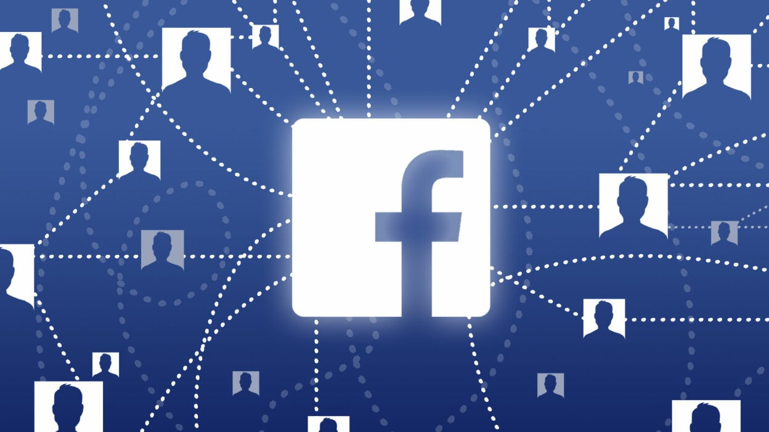
Implementation Facebook dataset
We used facebook dataset (good dataset):
This dataset consists of 'circles' (or 'friends lists') from Facebook.
Facebook data was collected from survey participants using this Facebook app.
The dataset includes node features (profiles), circles, and ego networks.
The dataset focuses on identifying communities within the ego-networks.
Different circles are formed by different aspects, such as family members or students who attended the same university and co-workers.
https://snap.stanford.edu/data/ego-Facebook.html

Slide 33
Implementation Facebook dataset
We used facebook dataset (good dataset) cont:
Dataset contains:
Nodes=4039.
Edges=88234.
Features:
Age (birthday).
Education.
School
Degree
anonymized feature which is political ideology.
First and last name
work

Slide 34
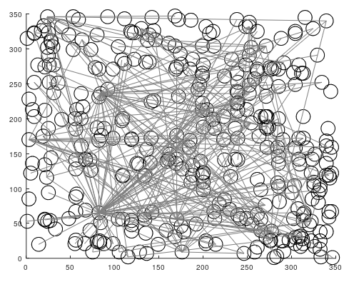
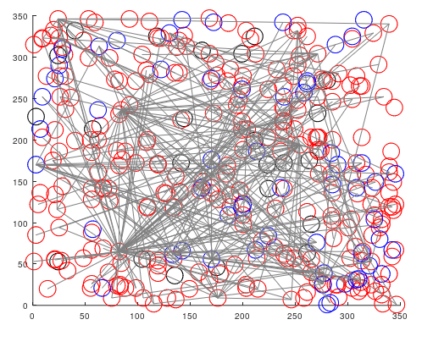
Implementation Facebook dataset
Before:
After:

Slide 35
Implementation Students Cooperation dataset:
Dataset Info:
Students Cooperation Social Network was constructed from the data collected during a "Computer and Network Security" course; a mandatory course at Ben-Gurion University.
The social network contains data collected from 185 participating students from two different departments.
The course's social network was created by analyzing the implicit and explicit cooperation among the students while doing their homework assignments.
The students' cooperation graph contained 185 nodes and 360 links and 3 types of links.
Data Science for Social Good Lab - Datasets (data4goodlab.github.io)

Slide 36
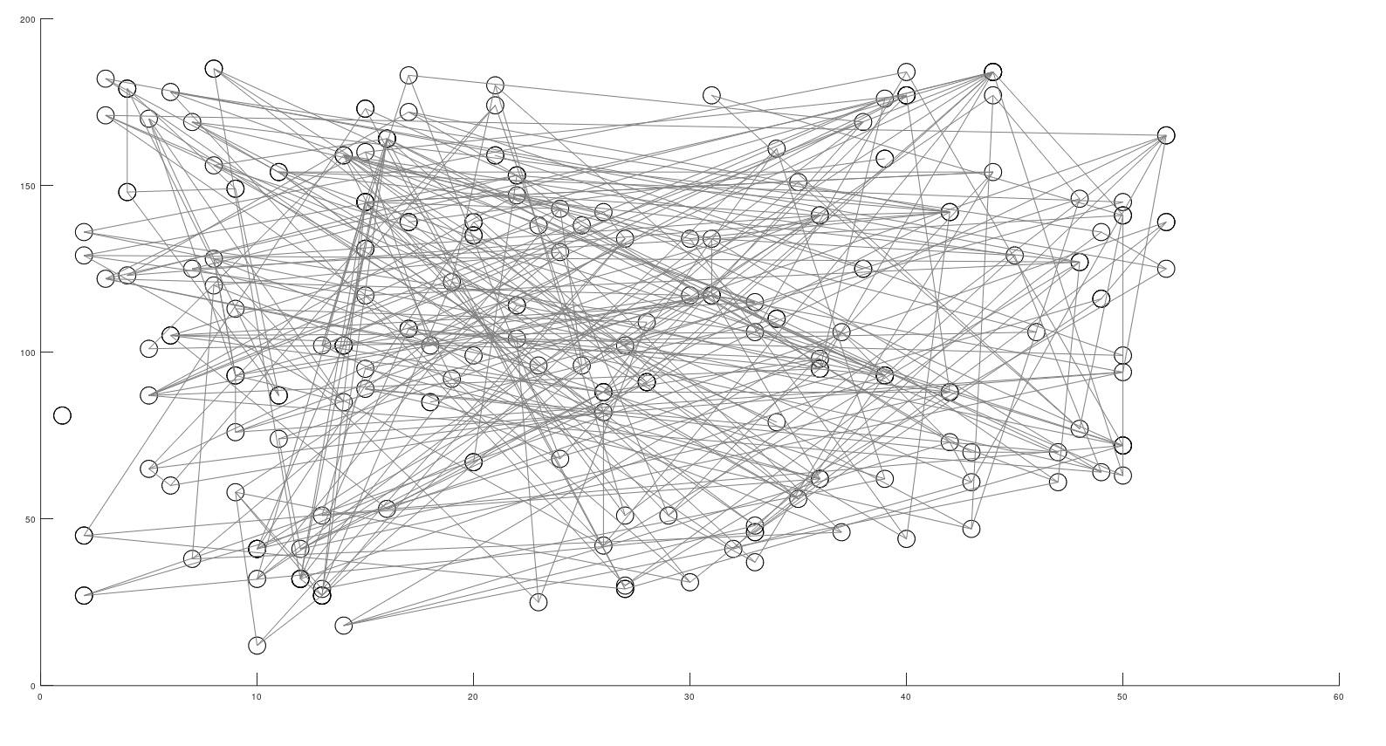
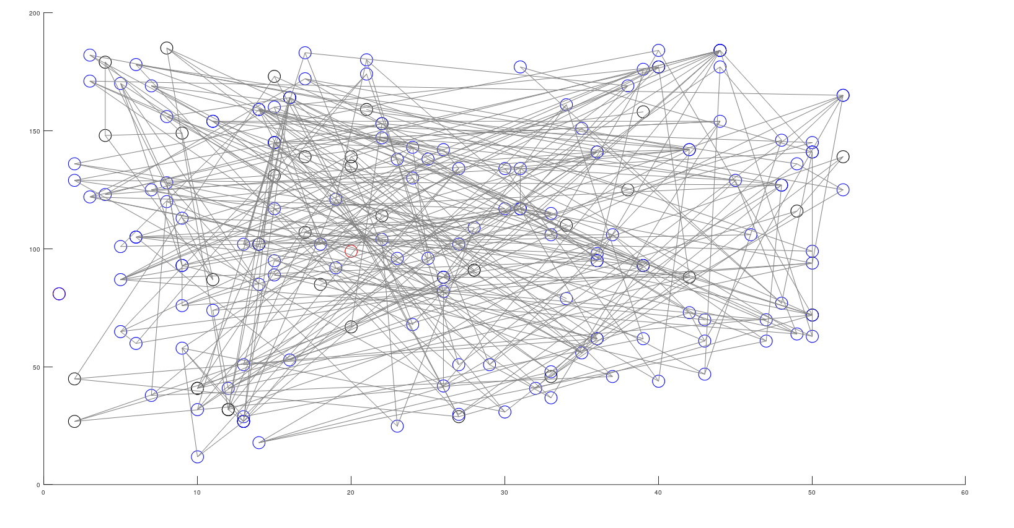
Implementation Students Cooperation dataset:
As we can see here is an implementation that did not work well:
Before:
After:

Slide 37
Implementation Students Cooperation dataset-cont.:
Issues explanations:
Initial label assignment: Label propagation algorithms typically start with a set of labeled nodes and propagate those labels to neighboring nodes through a random walk process. If all nodes are initially assigned the same label or labels that are very similar, it is highly likely that the random walk will converge to the same label for all nodes.
High similarity between nodes: If the similarity measure used for the random walk is too permissive and considers most nodes to be highly similar to each other, the propagation process might not identify distinct clusters or communities. Consequently, all nodes could converge to the same label.
Convergence issues: The random walk label propagation algorithm relies on iterative updates to propagate labels. If the algorithm fails to converge properly due to numerical issues or other convergence problems, all nodes could end up with the same label.

Slide 38
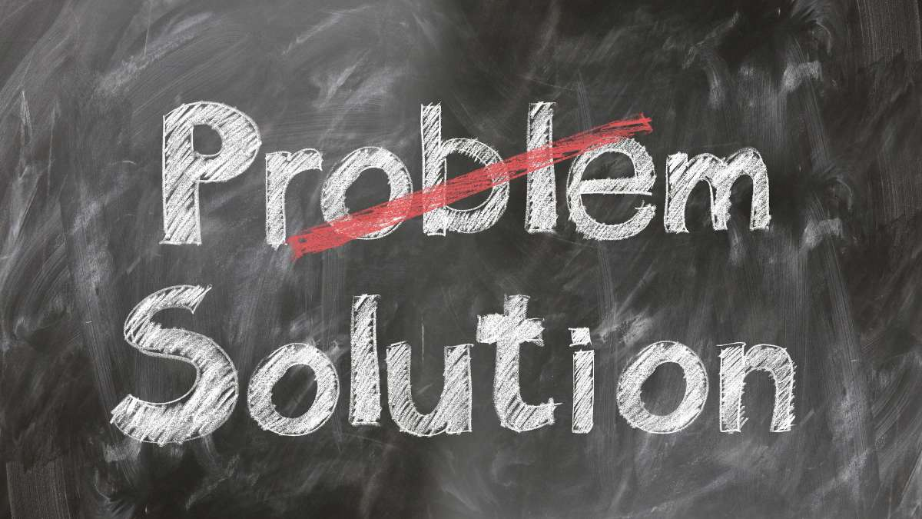
Implementation Students Cooperation dataset-cont.:
Dealing with issues :
Ensure a diverse initial label assignment that represents different classes or clusters in the dataset.
Consider using more advanced semi-supervised learning techniques or alternative algorithms if the data and problem characteristics are not well-suited for random walk label propagation.
Tune the parameters of the algorithm to achieve better convergence and performance.

Slide 39
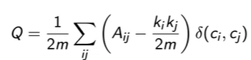
Modularity Measure
How to know if Label Propagation clustered well:
Modularity is a measure of the quality of a division of a network into communities.
Aij represents the presence or absence of an edge between nodes i and j.
k_i and k_j are the degrees (number of edges) of nodes i and j.
m is the total number of edges in the graph.
δ(ci, cj) is the Kronecker delta, which equals 1 if nodes i and j are in the same community (ci = cj) and 0 otherwise.

Slide 40
Modularity Measure cont.
The modularity measure, Q, for a graph clustering algorithm can take on different values.
Q > 0 (Positive Modularity):
-A positive modularity value indicates that the graph has more within-community edges than what would be expected by random chance.
- Higher positive values of Q generally indicate a better partition.
2. Q = 0 (Zero Modularity):
-The graph's community structure is on par with random assignment.
-No meaningful or significant communities are detected.
-The clustering doesn't improve upon a random division of nodes into groups.
3. Q < 0 (Negative Modularity):
-The community structure is worse than random assignment.
-The algorithm's partitioning is not capturing the true graph structure.
-Possible factors include the choice of algorithm or the data's nature.

Slide 41
Label propagation VS other clustering methods
Advantages of using Label propagation:
No Predefined Number of Clusters: Label Propagation doesn't need a predefined number of clusters, making it adaptable to various data structures.
Semi-Supervised: It incorporates labeled data to guide clustering, enhancing clustering quality.
Flexibility: Unlike some other methods, Label Propagation is versatile and can work well with different types of data and cluster shapes.

Slide 42
Label propagation VS other clustering methods
Disadvantages of using Label propagation:
Sensitivity to Initial Labels: Label Propagation's performance can be sensitive to the initial labeling of data points.
Dependency on Similarity Measure: It heavily relies on the choice of similarity measure or affinity matrix, which may not always be straightforward to determine.
Potential Scalability Issues: Constructing the similarity matrix can be computationally expensive, especially for large datasets, as it requires calculating pairwise similarities between all data points

Slide 43
Label propagation VS Spectral clustering
Let’s look about the differences between Label propagation to Spectral clustering:
Spectral Clustering:
Focuses on overall structure of data.
Uses math to group based on connections.
Good for complex-shaped clusters.
Needs the number of clusters in advance.
Sensitive to noise.

Slide 44
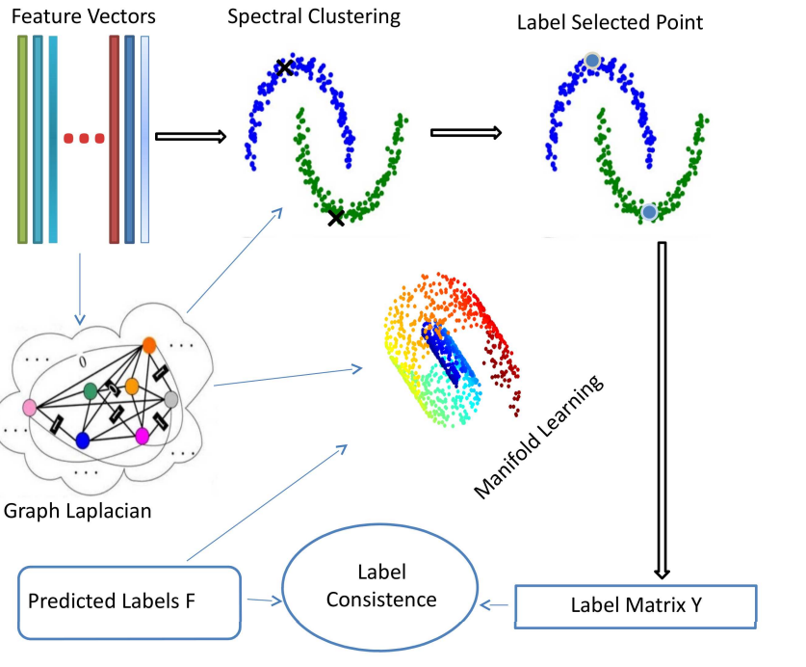
Label propagation VS Spectral clustering
Whereas Label propagation:
Spreads labels through neighbor connections.
Simple and efficient.
Can handle large datasets.
Can adapt to unknown cluster count.
May struggle with complex shapes.

Slide 45
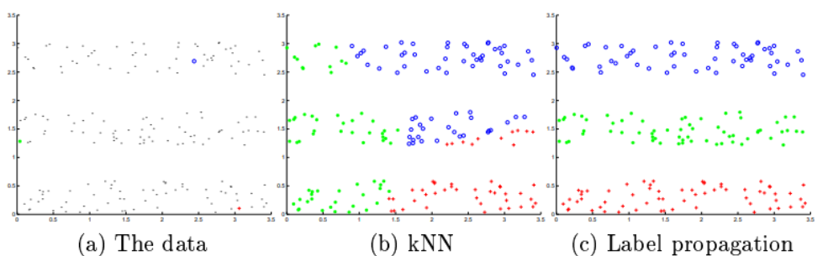
Label propagation VS KNN method
K nearest neighbors
Let’s look about the differences between Label propagation to KNN:
Source: https://mlg.eng.cam.ac.uk/zoubin/papers/CMU-CALD-02-107.pdf

Slide 46
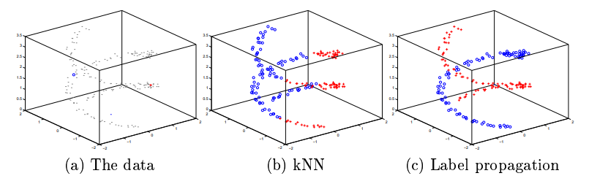
Label propagation VS KNN method
Let’s look about the differences in 3D:

Slide 47
Summary
The random walk method is a semi-supervised learning algorithm for label propagation in graphs or networks.
The algorithm creates a probability matrix based on the graph's connections and iteratively multiplies it by itself until convergence.
After convergence, the final label probabilities are multiplied by the adjacency matrix to propagate labels to neighboring nodes.
Random walk label propagation is efficient when labeled data is limited and data points within a cluster share the same label.
It may not perform optimally with noisy, high-dimensional, or imbalanced data.

Slide 48
